Slide 1
Self Avoiding Random Walk
By Beau Goldberg and Joe Kelly

Slide 2
Modeling polymers with SAW
Limits to this method:
Restricted to a 2-D grid
Monomers do not always align themselves at 90º angles
Advantages to this method:
Much simpler to ensure it doesn’t cross over with itself as the locations are restricted to a Cartesian Grid

Slide 3
Our Method
Highly based on conditionals
Walk is based on code for the movements
0 – Left ; 1 – Up ; 2 – Right ; 3 – Down
Movement corresponding with code is set as ‘forward’ movement
Next move goes randomly left, right or forward from the ‘forward’ direction
Weight method also based on conditionals

Slide 4
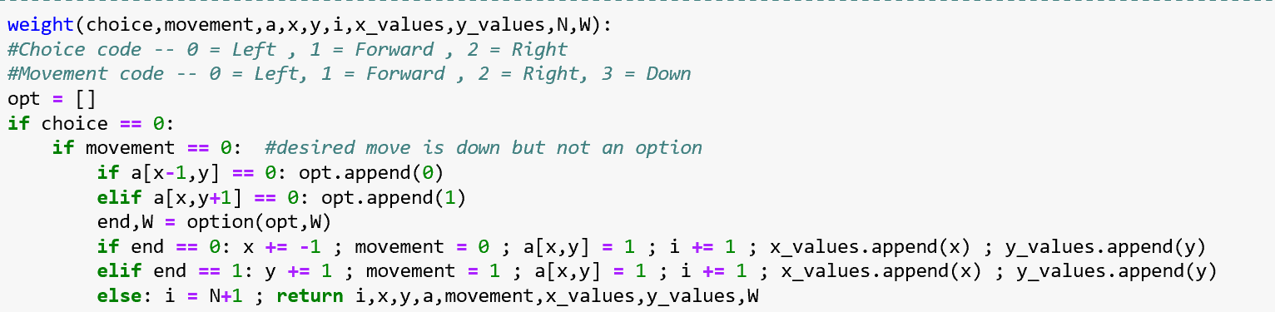
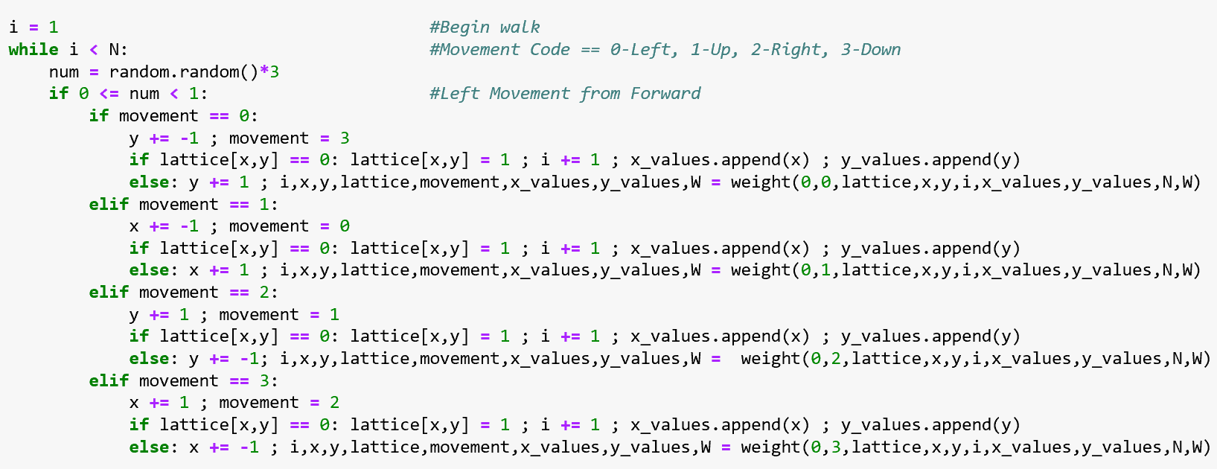

Slide 5
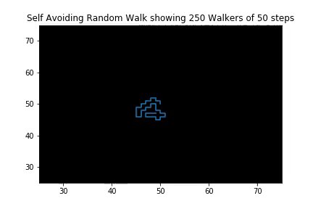
Weighted

Slide 6
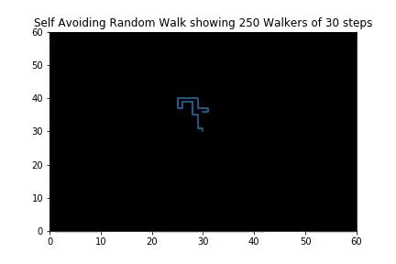
Weighted

Slide 7
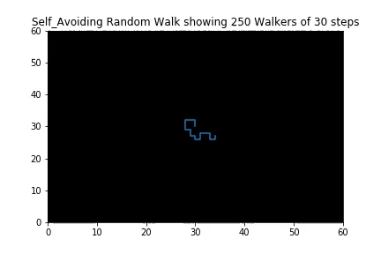
Unweighted: Less Dense

Slide 8
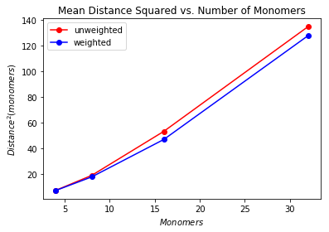
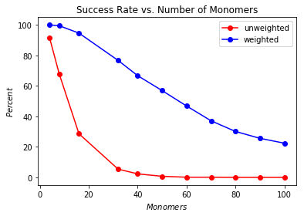
Results

